Slide 1

Efficient Acoustic Modelling of Large Spaces using Time Domain Methods
The Evaluation of Three Time Domain Numerical Methods for Solving the Acoustic Wave Equation, Applied to Solving Large Domains
S Durbridge
May 2017

Slide 2
Efficient Acoustic Modelling of Large Spaces using Time Domain Methods
Motivation
Why model large spaces?
Large Room Acoustics
Wave Acoustics
Acoustic Modelling Methods
Physical Models
Parameter Approximation Equations
Ray Tracing
Numerical Methods
Finite Element Methods
Boundary Element Methods
Finite Difference Methods
Sparse Finite Difference Time Domain
Finite Difference Frequency Domain
Experiment
Method
Results
Analysis
Solving Architecture
Conclusion
What this work Shows
Further work to be conducted
References

Slide 3
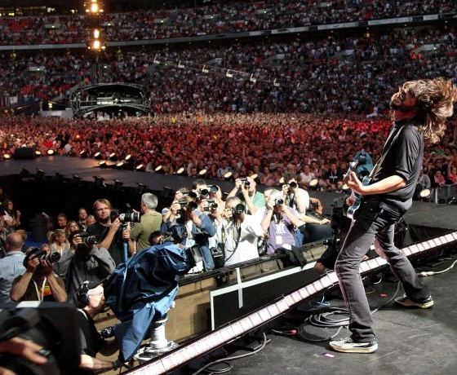
Motivation
Why model large domains?
http://www.wallpaperup.com/187034/music_live_Foo_Fighters_Dave_Grohl.html

Slide 4
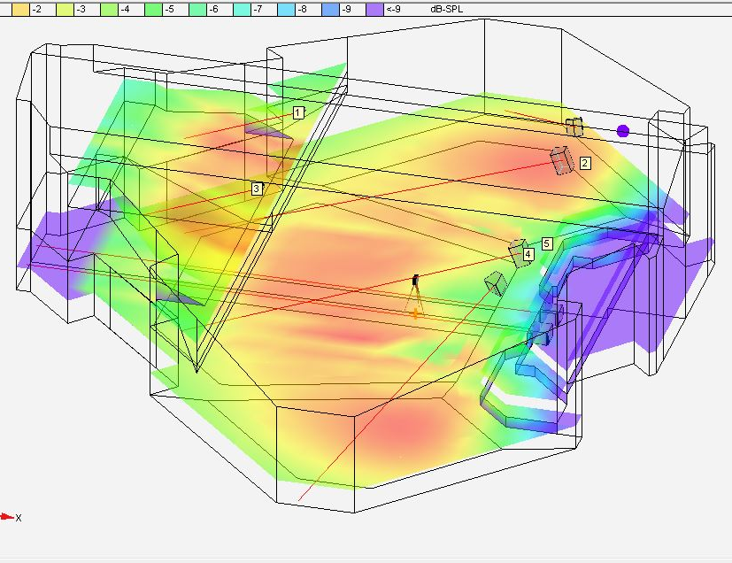
Sound System Design
Prototype array configurations
Try different systems
Placement
Time of arrival
Equalisation
Office Virtual Soundcheck
Optimise design for intelligibility
Improve deployment time
Build a basic system ‘image’ in model
Tweak system settings on the day
Prototype system tools
Adaptive (dynamic) filtering
Spectral tilt for line arrays
Dynamic array steering
http://toneproperav.com/design-1/

Slide 5
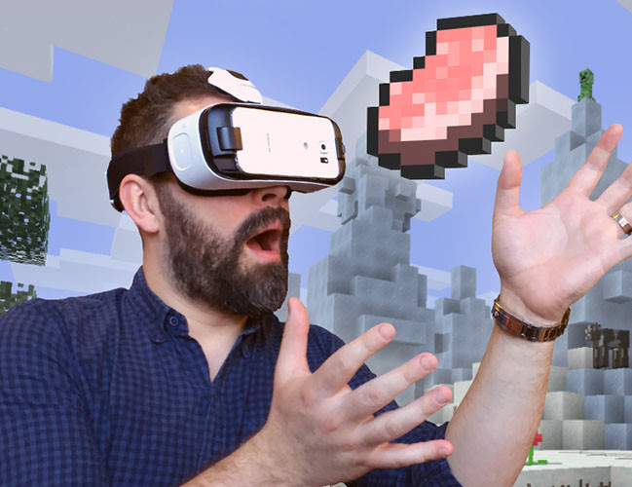
Auralization
Virtual Reality
Video Games
Home Entertainment
Evaluation of building and system designs prior to build
https://www.rt.com/usa/341199-minecraft-goes-vr/

Slide 6
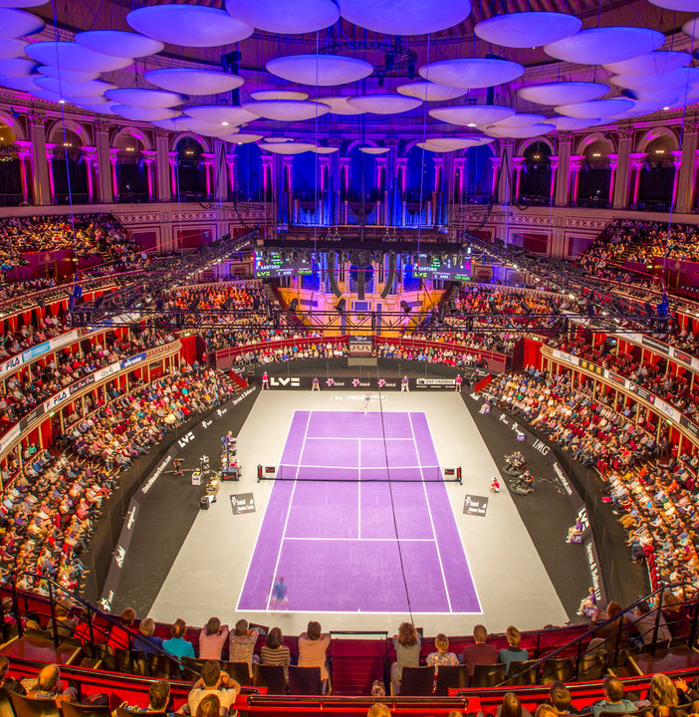
Large Room Acoustic Properties
Wave Acoustics
Reverberation
Direct to Reverberant Ratio
Room Modes
http://www.royalalberthall.com/tickets/events/2017/champions-tennis//

Slide 7
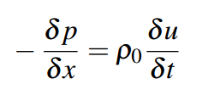
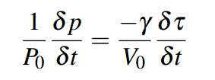
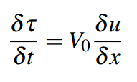
Wave Acoustic
Physical Basis
Momentum Equation
Gas Law
Conservation of Mass
Notes:
P pressure
X = x direction
u = velocity
t = time
P0 = ambient pressure
y = Adiabatic gas constant for air
V0 = gas density
tau = displacement of the volume

Slide 8
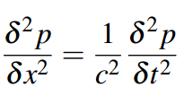
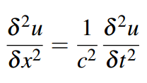
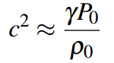
Wave Acoustic
Wave Equation

Slide 9
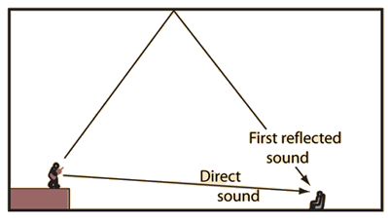
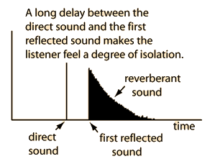
Reverberation
Reflections
http://hyperphysics.phy-astr.gsu.edu/hbase/Acoustic/refdel.html

Slide 10
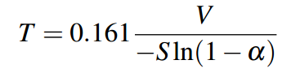
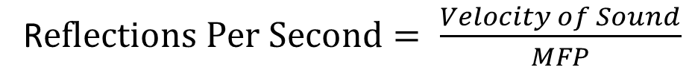
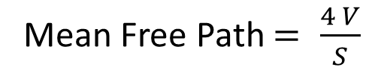
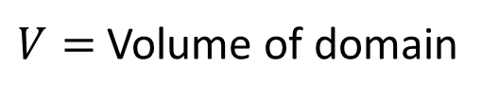
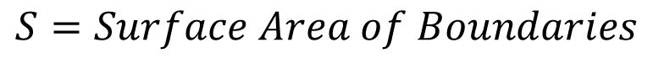
Reverberation
Norris-Eyring Reverberation Time Equation (RT60)
$$S=Surface Area of Boundaries$$
$V=$Volume of domain
Mean Free Path $= \frac{4 V}{S}$
R$eflections Per Second= \frac{Velocity of Sound}{MFP}$

Slide 11
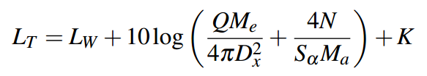
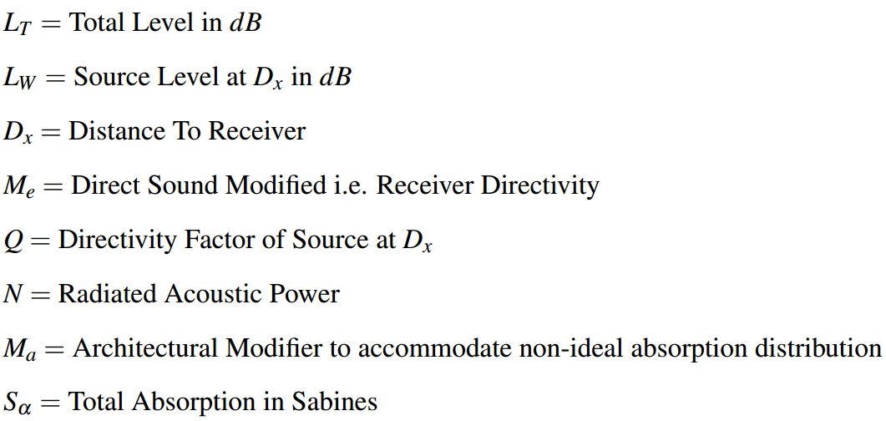
Direct to Reverberant Ratio
Modified Hopkins-Stryker Equation

Slide 12
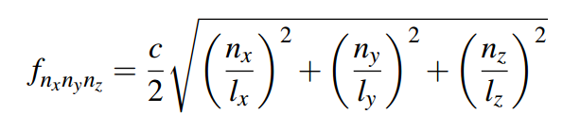
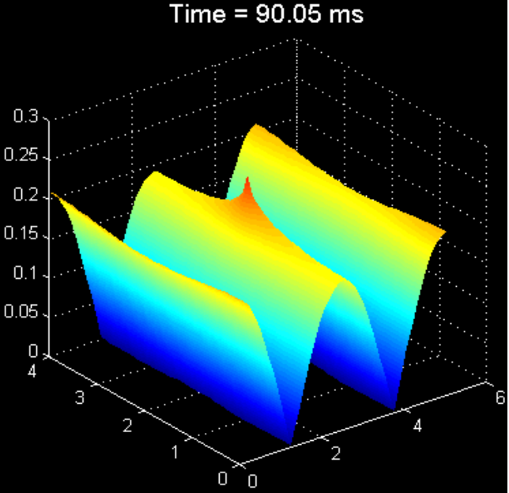
Room Modes
Room Eigenfrequency Equation
C = speed of sound
n = resonance order
l = dimension
http://adamjhill.com/AJHILL/wp-content/uploads/2017/05/Hill-PhD-Thesis.pdf

Slide 13
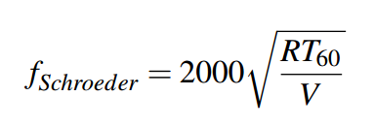
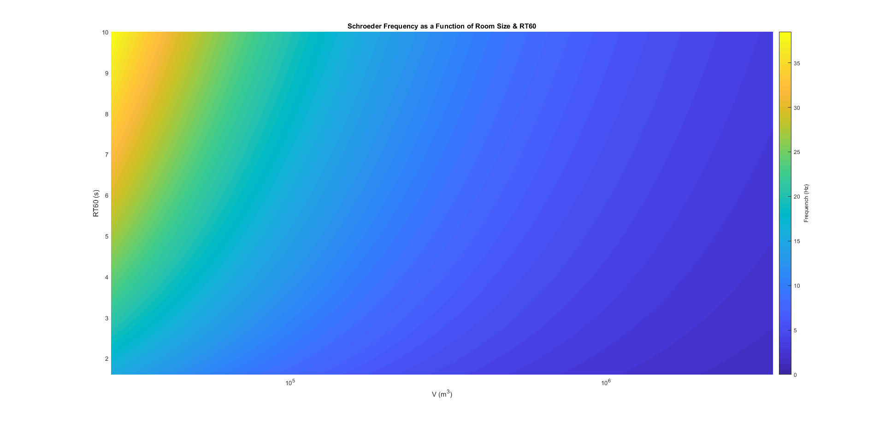
Room Modes
Schroeder Frequency
http://www.linkwitzlab.com/rooms.htm

Slide 14
Recap
Wave propagation
Force = Mass * Acceleration
Longitudinal Waves
Ripples of pressure
Reverberation
Acoustic waves reflect and scatter
May increase loudness – Haas Effect
May decrease intelligibility – Masking & Direct to Reverberant Ratio
Balance of acoustic absorption and sound system power can improve direct to reverberant ratio
Room Modes
Locally extreme pressure fluctuations
May cause spectral imbalance across domain
Schroeder Frequency can be very low in large domains with appropriate reverb decay times

Slide 15
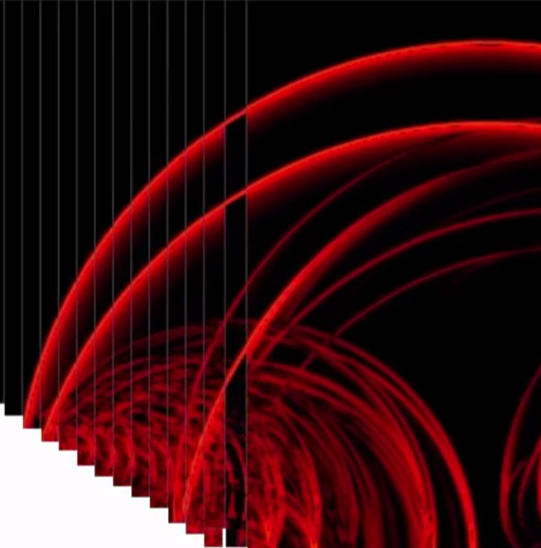
Acoustic Modelling Methods
Physical Models
Parameter Approximation Equations
Ray Tracing
Numerical Methods
Finite Element Methods
Boundary Element Methods
Finite Difference Methods
Sparse Finite Difference Time Domain
Finite Difference Frequency Domain

Slide 16
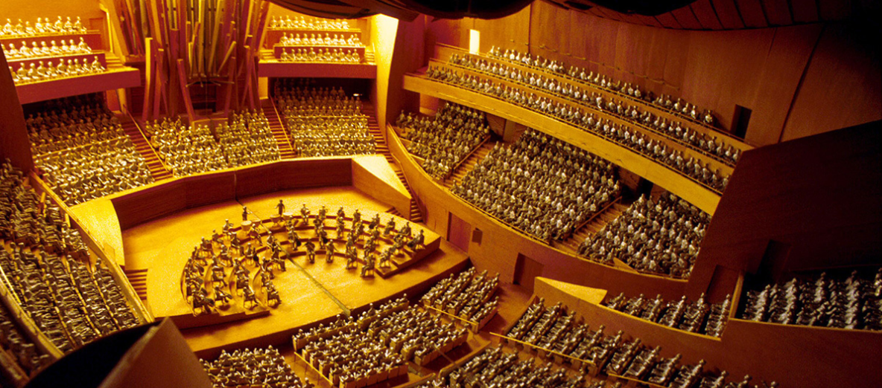
http://wdch10.laphil.com/wdch/acoustics.html
Physical Scale Models

Slide 17
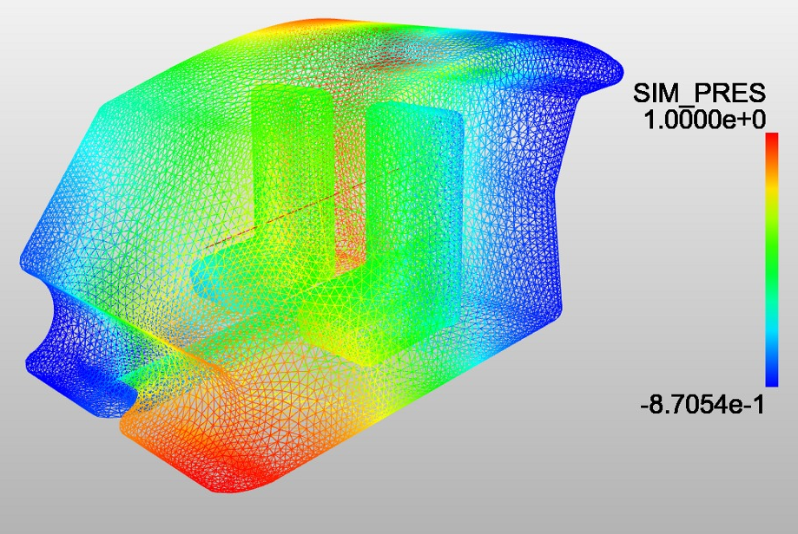
https://www.simscale.com/wp-content/uploads/2015/11/acoustic-eigenmodes.jpg
Finite Element Method

Slide 18
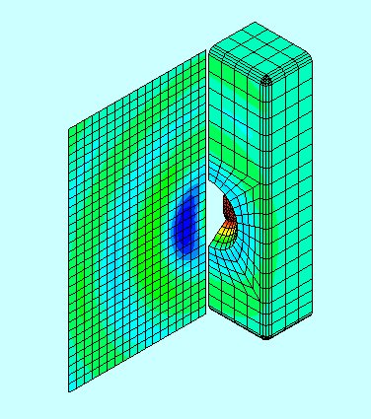
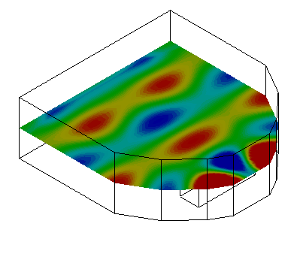
http://www.pafec.info/pafec/
Boundary Element Method

Slide 19
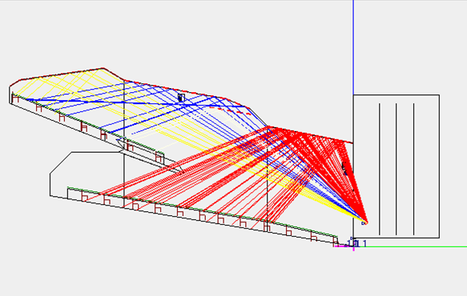
http://ease.afmg.eu/index.php/reflection-pattern-studies-with-ray-tracing.html
Ray Physics Methods

Slide 20
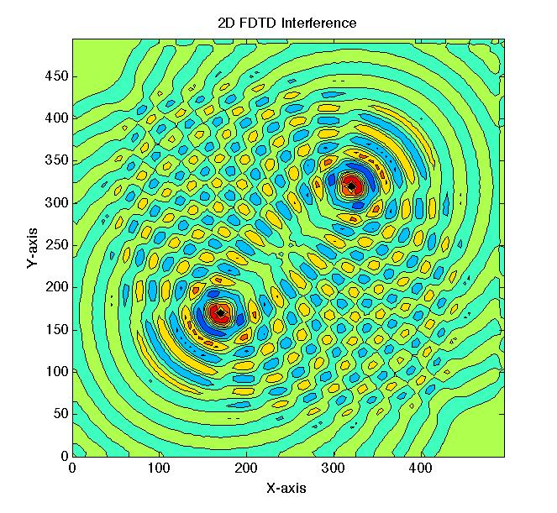
Finite Difference Methods
https://uk.mathworks.com/matlabcentral/fileexchange/55301-two-dimensional-wave-interference-using-finite-difference-time-domain-method--fdtd-

Slide 21
Finite Difference Methods
Finite Difference Time Domain

Slide 22
Finite Difference Methods
Sparse Finite Difference Time Domain

Slide 23
Finite Difference Methods
Pseudo-spectral Time Domain / Finite Difference Frequency Domain

Slide 24
Experiment

Slide 25
Conclusion

Slide 26
References

